Slide 1
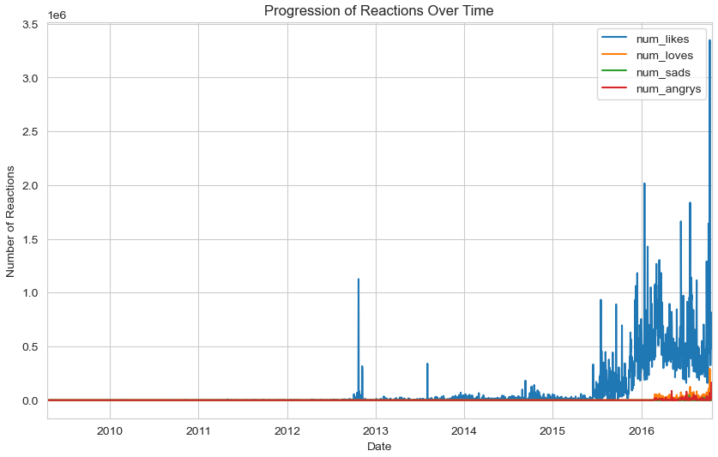
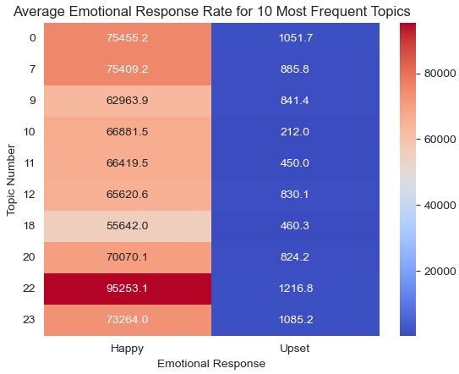
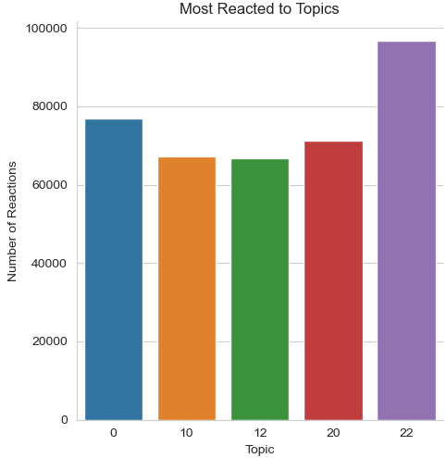
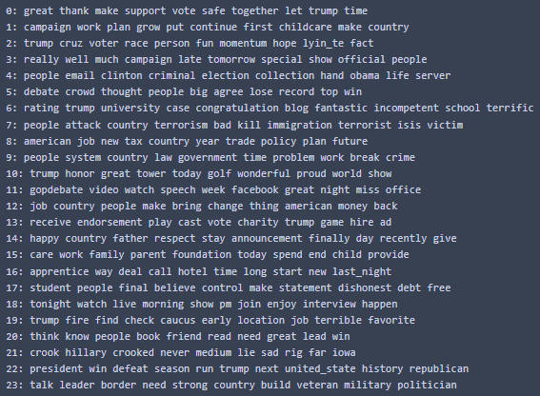
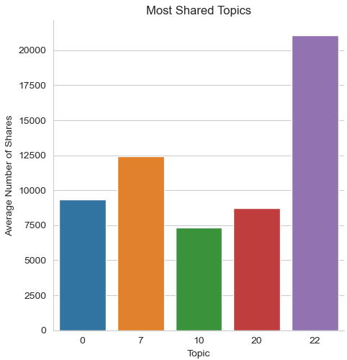
Analyzing Reactions to Donald Trump’s Facebook Updates (2009-2016)
Abstract
Challenges
Examples
Evaluations
The purpose of this project was to perform topic analysis on Donald Trump's Facebook status updates to gain insights into the content that resonated with his audience. The content of Trump’s Facebook status updates was analyzed to create coherent topics using LDA topic modeling. The top 10 most frequent topics were analyzed to determine whether respondents reacted positively or negatively. Additionally, the topics that generated the most shares and reactions were analyzed to gain a better understanding of the content that was most effective in engaging Trump's audience on Facebook. Overall, the project provides valuable insights into the content that resonated with Trump's audience on Facebook and can be used to inform future social media strategies.
One of the challenges was determining the optimal number of topics to model. I am happy with my results using 24 topics however I believe there is still room to fine tune the results for more optimal coherence.
Another challenge was determining how to handle how positive and negative reactions were calculated. Due to the nature of the data, the number of variables composing each measure were imbalanced. In order to maximize readability of the heat map, the number of laughing reactions were not included in the final positive score.
Trump’s Facebook status update engagement levels increased dramatically from near zero to tens of thousands after he announced his bid in the presidential election
Reactions to Trump’s status updates were vastly positive, typically outnumbering the negative reactions by well over 70:1
The majority of the “most frequent topics” received roughly 60,000 to 70,000 positive reactions per status update
Positive topics were more frequently posted than negative topics except for “Terrorism” which was one of the top 10 most frequently posted topics
The second most shared topic after “Trump Wins Election” was “Terrorism”
Framework
Once the data was processed, the first step of topic extraction was to determine a convergence baseline for the number of passes. After the initial optimal value for the passes parameter was determined, multiple models were created to test the optimal number of topics to maximize topic coherence. The results were plotted and analyzed.
The most notable coherence spikes were seen at 8, 12, 20, and 24 topics. New optimal pass parameters were determined using convergence for each number of topics and models were trained. The keywords of the topics were analyzed by hand to determine which ones had the most coherence to the human eye. The lower topic-count models appeared to encapsulate multiple topics within one which suggests more topics would be ideal. Ultimately, the 24-topic model was chosen to be used for further analysis. The top 10 keywords for each topic can be seen below.
Objective
Conclusions
This project analyzes a dataset of Donald Trump's Facebook status updates to determine the sentiment and topics that generated the most engagement from his audience. The dataset includes various metrics such as the number of reactions (likes, loves, sads, and angrys), shares, and comments for each post. LDA was used to extract coherent topics from Trump’s status updates so that various charts and analysis techniques could be applied to visualize the data and draw insights into the audience's reactions to Trump's posts.
After analyzing the dataset, I’ve concluded that Trump’s Facebook statuses are largely reacted to by people who like him. Topics that had negative connotations such as terrorism in topic 7 or Hillary Clinton in topic 21, had lower total reaction levels than topics that had positive connotations such as topic 22 (Trump winning the election). Despite its negative connotation, topic 7 (terrorism), was the second most shared topic. It also had the 3rd most positive reactions on average. However, it did not make it into the top 5 reacted to topics. This suggests that although status updates regarding terrorism were less frequent than other topics, the response was zealous when they appeared.
References
Delpisheh, E. (2023, March 25) Donald Trumps Facebook Statuses [Dataset].

